Slide 1
BIOSIMILAR: APA YANG
PERLU KITA PERHATIKAN
DARI PEDOMAN YANG ADA
SEKARANG?
SAID.GLA.17.06.0220 (04/18)
| 1

Slide 2
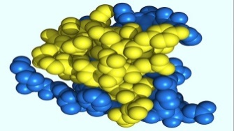
Biosimilar bukan Generik
Insulin biosimilar di desain mirip dengan originator insulin
Chemical product
e.g. Aspirin®
Biologic
e.g. Insulin
Sintetis kimia
Proses produksi yang berbeda akan menghasilkan proses akhir yg berbeda
Branded
chemical product
Generik
Produk acuan
(original produk)
Biosimilar
Kessler et al. Nephrol Dial Transplant 2006; 21(Suppl 5): v9-12; Schellekens. Nephrol Dial Transplant 2005; 20(Suppl 4): iv31-36; Schellekens. Clin J Am Soc Nephrol 2008; 3: 174-8; Schellekens et al. Trends Pharmacol Sci 2002; 23(3): 119-21;
Krämer. J Endocrinol Invest 2008; 31: 479-88.
| 2
Notes:
Biosimilars are not generics
Chemical products are low molecular weight drugs, typically with a MW below 1000 daltons (1 kDa), and can be chemically synthesized i.e. do not require any biological systems for their manufacture
Generics are identical copies of chemical products
Biologics are recombinant proteins of high molecular weight (e.g. 5808 daltons for insulin) with complex structure and are manufactured using sophisticated recombinant technology involving the use of biological systems
Biosimilars can only be similar; they cannot be identical to the reference product that they are attempting to copy after patent expiry
Biosimilars are referred to as “similar biological medicinal products” by the EMEA in the EU and as “follow-on biologics” by the FDA in the US
Of note: an additional important difference between chemical products and biologics relates to impurities. Quality assurance assays for biologics are less sensitive and precise than for chemical products. In the manufacture of biologics, impurities are not predictable and are not easily monitored
References
Kessler et al. Nephrol Dial Transplant 2006; 21(Suppl 5): v9–12.
Schellekens. Nephrol Dial Transplant 2005; 20(Suppl 4): iv31–36.
Schellekens. Clin J Am Soc Nephrol 2008; 3: 174–8.
Schellekens et al. Trends Pharmacol Sci 2002; 23(3): 119–21.
Krämer. J Endocrinol Invest 2008; 31: 479–88.

Slide 3
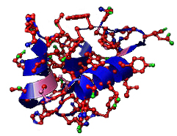
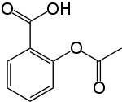
Produk biologi memiliki struktur molekul yang jauh lebih besar dari produk kimia, dengan tingkat kompleksitas yg tinggi
Chemical products
(produk kimia)
Biologics products
(produk biologis)
Memiliki massa molekul kecil
e.g. 180 daltons (Aspirin®)
Memiliki massa molekul besar
e.g. ≈5808 daltons (insulin)
Krämer. J Endocrinol Invest 2008; 31: 479–88.
| 3
Notes:
Biologics are complex molecules
Size: Biologics are much larger molecules than chemical products
In contrast to chemical products, which are small, simple molecules that are easy to copy, biologics are large, complex protein molecules that cannot be copied
For example, insulin is more than 30x larger than aspirin
References
Krämer. J Endocrinol Invest 2008; 31: 479–88.

Slide 4
Produk biologis memiliki struktur molekul yang lebih kompleks
Produk biologis mengandung protein yang mengalami modifikasi post translational selama pembuatannya, sehingga berkontribusi terhadap kompleksitas
Aktivitas biologis
Immunogenisitas
Modifikasi Post-translational
dapat mengakibatkan
Kelarutan (Solubility)
Kestabilan
Covic et al. Nephrol Dial Transplant 2008; 23: 3731–7;
Kuhlmann et al. Nephrol Dial Transplant 2006; 21 (Suppl 5): v4–8; Schellekens. Nat Rev Drug Discov 2002; 1: 457–62.
| 4
Notes:
Biologics are complex molecules
Proteins undergo post-translational modifications during their manufacture which contribute to their complexity
Post-translational modifications are chemical modifications of the protein that occur following translation (assembly of the amino acid chain), such as glycosylation, ubiquitination or the formation of disulfide bridges
Post-translational modifications can affect
Biologic activity
For example, the in vivo activity of epoetin can be enhanced by increased glycosylation and sialation through a reduced serum clearance rate
Immunogenicity
Reduced glycosylation is believed to lead to increased immunogenicity through increased exposure of antigenic sites or through reduced solubility
Stability
Degradation can produce variations of the protein that may lead to differing clinical properties such as biologic activity, serum half-life or immunogenicity
References
Covic et al. Nephrol Dial Transplant 2008; 23: 3731–7.
Kuhlmann et al. Nephrol Dial Transplant 2006; 21 (Suppl 5): v4–8.
Schellekens. Nat Rev Drug Discov 2002; 1: 457–62.

Slide 5
Proses produksi yang berbeda menghasilkan produk yang berbeda
Adenine (A)
Cytosine (C)
Thymine (T)
Guanine (G)
Pemilihan urutan DNA
Kloning
Pembudidayaan
Produksi Protein
Permurnian
Formulasi
Perbedaan dalam urutan DNA dapat menghasilkan variasi protein rekombinan yg dihasilkan
Perbedaan dalam expression system dapat menyebabkan varian dalam tingkat ekspresi dan stabilitas protein rekombinan
Media pertumbuhan yang berbeda dapat mengakibatkan hasil protein rekombinan yang berbeda dan munculnya produk sampingan
Perbedaan dalam garis sel dapat menyebabkan berbagai modifikasi pasca translasi protein rekombinan
Perbedaan dalam proses pemurnian dapat menyebakan variasi produk akhir (co: peningkatan pembentukan agregat)
Perbedaan dalam formulasi juga mempengaruhi produk akhir
Kuhlmann et al. Nephrol Dial Transplant 2006; 21(Suppl 5): v4–8.
| 5
Notes:
Different manufacturing processes produce different products
Biosimilars are produced by different manufacturing processes than reference products
Processes used in the manufacture of biologics are proprietary, therefore, manufacturing processes are inevitably different
Compared with the reference product, steps in the manufacturing process for a biosimilar may be very similar or very different
Choice of DNA sequence for the recombinant protein may be the same or different
Expression system (created by the insertion of a DNA sequence using a vector into a host cell) will be different
Cultivation and protein production steps will be different as they must be optimized for the expression system
Differences in any step of the process for synthesis of the protein lead to variations in the protein produced and any associated by-products
Purification steps will be different as they are dependent upon the protein and by-products produced during cultivation
Different purification steps will require different quality control steps
Formulation may be the same or different
As the manufacturing process is proprietary information, biosimilars manufacturers must develop their own processes independently. As a result, a biosimilar will never be identical to the reference product, but can only be similar
References
1. Kuhlmann et al. Nephrol Dial Transplant 2006; 21(Suppl 5): v4–v8.

Slide 6
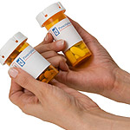

Interchangeability and Substitution
(Pertukaran dan Pergantian)

Slide 7
Semua produk biologis berpotensi imunogenik
Semua obat yang mengandung protein rekombinan memiliki potensi untuk dikenali sebagai benda asing oleh sistem imun
Mekanisme akan produksi antibodi
Reaksi ke antigen
(classical vaccine response)
Merusak ambang toleransi imun
(merusak toleransi sel B)
Terjadi secara perlahan, setelah terpapar dalam jangka panjang, akan hilang setelah perhentian penggunaan obat
Kemungkinan disebabkan oleh ketidak murnian dari obat biologis
Schellekens. Clin J Am Soc Nephrol 2008; 3: 174–78.
| 7
Notes:
All biologics are potentially immunogenic
All recombinant protein drugs have the potential to be recognized as foreign by the patient’s immune system
Immunogenicity of a human recombinant protein product is dependent on a number of factors including:
Presence of undesired exogenous proteins and DNA
Viruses and endotoxins
Impurities and aggregates
Immunogenicity of recombinant proteins is based on two different mechanisms
The first mechanism consists of a classical immune response to antigens. It is mediated by T cells and occurs rapidly
The second mechanism occurs in response to human recombinant proteins and results in breakdown of B cell tolerance
References
Schellekens. Clin J Am Soc Nephrol 2008; 3: 174–8.

Slide 8
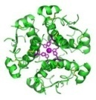
Imunogenisitas memiliki konsekuensi klinis
Efek Antibodi tergantung dari Titer dan Afinitas
Efek yang paling umum adalah perubahan efikasi
  Menurunnya aktivitas obat biasanya terjadi karena jumlah antibodi yang berusaha menetralkan produk tersebut
Munculnya reaksi imun
(reaksi alergi, serum sickness)
Efek samping yang serius dapat terjadi jika antibodi ikut menetralkan aktivitas protein endogen lainnya (protein yang dihasilkan dari dalam tubuh)
Schellekens. Clin J Am Soc Nephrol 2008; 3: 174–78.
| 8
Notes:
Immunogenicity may have significant clinical consequences
Clinical consequences of an immunogenic response are variable – effects can range from little or none to life threatening
Effects are dependent on the level of antibody response (titres), the affinity and the type of antibody (binding antibodies vs. neutralizing antibodies [which interfere with or neutralize the biological properties of the protein])
The most common clinical consequence of an immune response to a biologic is loss of efficacy (e.g. loss of effect of Factor VIII in haemophilia due to neutralising antibodies (inhibitors) binding to the recombinant Factor VIII)
Immunogenicity may manifest as safety and tolerability issues ranging from general immunological side effects such as serum sickness to serious side effects if antibodies neutralise a protein with essential biological activity; e.g. case of megakaryocyte-derived growth factor (MDGF) where antibodies against the biologic also neutralised endogenous thrombopoietin leading to severe thromobocytopenia
References
1. Kessler et al. Nephrol Dial Transplant 2006; 21(Suppl 5): v9–v12.

Slide 9
Imunogenisitas adalah faktor kunci pada produk biologis atau biosimilar
Semua produk biologis berpotensi untuk terjadinya kejadian imunogenik¹
Kualitas produk yang berbeda dapat menyebabkan kejadian imunogenik ²
contoh: kemurnia, agregat
Untuk alasan ini EMA tidak memberikan status interchangeability (produk dapat ditukar), ke produk biosimilar. Serta tidak memberikan informasi tambahan bahwa produk biologis dapat di subtitusi langsung di level farmasi.
Perbedaan yang kecil dalam proses produksi dapat mengakibatkan imunogenik ³
Imunogenisitas dapat memiliki konsekuensi klinis yg signifikan ²
Imunogenisistas tidak dapat diprediksi ⇒
Pemantauan PV (farmakovigilance) jangka panjang sangat diperlukan²
1. Rotenstein L, et al. Clinical Diabetes 2012; 30:138‒50; 2. Roger SD and Goldsmith D. J Clin Pharm Ther 2008;33:459–64; 3. Ebbers HC, et al. Expert Opin Biol Ther 2012;12:1473–85.

Slide 10
Device insulin yang digunakan insulin menambah kompleksitas insulin biosimilar
Insulin
biosimilar
?
?
Disposable pen
?
Jarum
?
?
Pompa insulin
Fitur keamanan
lainnya
Cartridges for
reusable pen
| 10
Notes:
Insulin administration devices add to the complexity of insulin biosimilars
The dosing accuracy of biosimilar insulins depends on the quality of and compatibility with the administration device chosen
For insulins:
Insulin pens are controlled by a legal framework to ensure dose accuracy and visibility, formulation stability, function at various orientations and durability of labels and distinguishing marks
For biosimilars:
Compatibility between insulin biosimilars and existing administration devices must be demonstrated in order to ensure patient safety
Prefilled, disposable pens have fully integrated insulin cartridges and pens are discarded after use. They require minimal training and attention to detail to enable use
Reusable pens which have a lifetime of up to 5 years contain replaceable cartridges of insulin; patients insert the insulin cartridge, and then are able to dial and deliver their dose. When the cartridge is empty, it is discarded and a new one inserted

Slide 11
Insulin biosimilar: pertimbangan utama
Produk biologis seperti insulin, memiliki molekul yang jauh lebih kompleks karena dalam proses pembuatannya bertahap-tahap dan melibatkan organisme hidup
Perbedaan yang kecil dapat terjadi pada setiap tahap proses pembuatan, sehingga dapat menghasilkan produk akhir yang berbeda.
Tidak memungkinkan produk biosimilar memiliki keidentikan dengan produk originalnya, karena tidak dapat dikategorikan sebagai produk generik
| 11
Notes:
Slide resource for insulin biosimilars: key points
Several aspects should be considered in the use of insulin biosimilars as follows:
Biosimilars are not generics – in contrast to chemical products, which are small, simple molecules that are easy to copy, biologics, produced by living organisms are large, complex protein molecules that cannot be copied exactly
Manufacturing of biologics is a complex, multi-step process and each step is associated with inherent variability. Small differences in manufacturing may make different products
Regulatory requirements for biosimilars in the EU reflect that they are not generics and that identical copies of biologics cannot be made. Biosimilars must provide relevant pre-clinical and clinical data for marketing authorization as the primary concerns are quality, efficacy and safety
All biologics are potentially immunogenic and immunogenicity is one of the most important safety issues for biosimilars. Current technology does not permit us to predict immunogenicity of a biologic, therefore clinical consequences of an immunogenic response are unpredictable
Despite the fact that a number of countries do not yet have established regulatory guidelines specifically for biologics and/or biosimilars, regulatory authorities take a pro-active approach in the principles guiding biosimilar development
External input may be provided as follows
Consultation with experts on topics such as immunogenicity, PK/PD issues, etc.
Face-to-face meetings with regulatory bodies and experts
Visit of manufacturing facilities to better understand the complex manufacturing process
References
Weise et al. Blood October 23, 2012. (DOI 10.1182/blood-2012-04-425744)

Slide 12
Potensi perbedaan produk original dan produk biosimilar

Slide 13
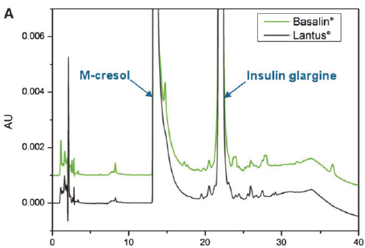
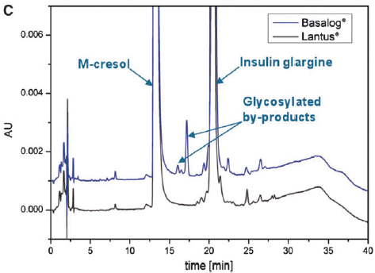
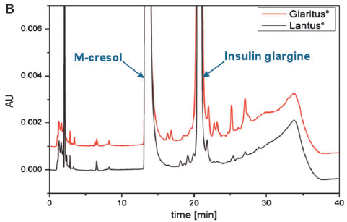
Profil kemurnian yang berbeda
Owens DR. et al. Diabetes Technology & Therapeutics. 2012;14(11):989-96.
Innovator Glargine
Intended-copies (biosimilar)

Slide 14
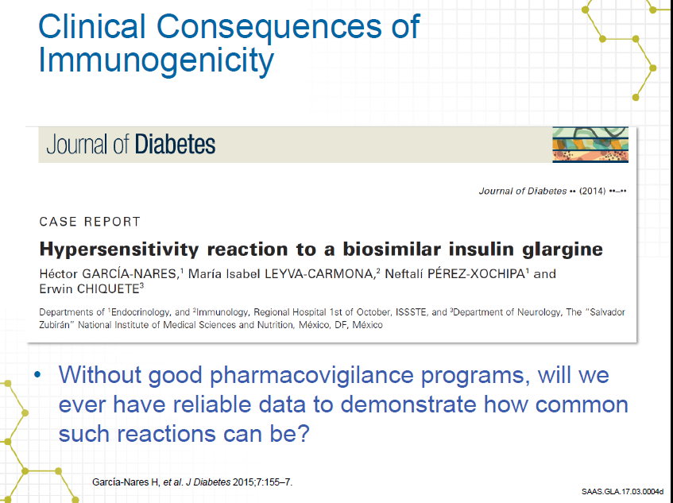
Munculnya reaksi hipersensitivitas karena penggunaan biosimilar

Slide 15
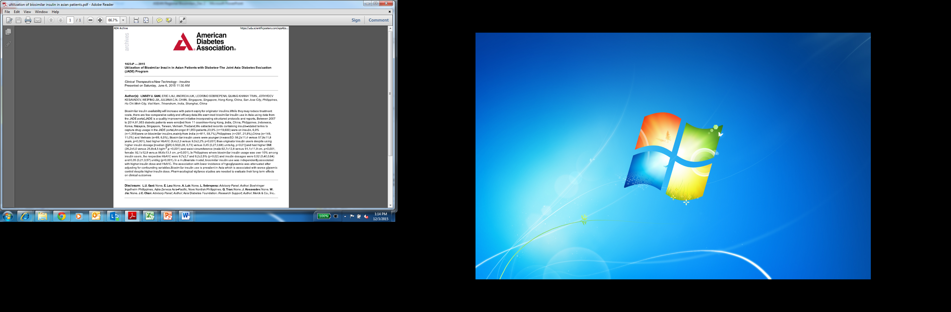
Kontrol glikemik yang lebih buruk meski dosis insulin yang dibutuhkan lebih tinggi
Study mengenai penggunaan biosimilar di Asia
Jade Registry June 2015
Presented on June 6, 2015 by Prof Julianna Chan (Hong Kong)
Penggunaan insulin biosimilar yang beragam lazim terjadi di Asia, dan dikaitkan dengan kontrol glikemik yang buruk meskipun dosis insulinnya lebih tinggi. Studi PV (pharmacovigilance) diperlukan untuk mengevaluasi efek jangka panjang pada hasil klinis

Slide 16
Hal-hal yang harus diperhatikan pada produk biosimilar
Potensial perbedaan | Pertimbangan Klinis
Variabilitas dari batch ke batch | Efek glikemik yang tidak konsisten Gangguan pengaturan gula darah karena adanya ekskursi glikemik
Sedikit perbedaan dalam hal efikasi | Kemungkinan membutuhkan dosis lebih tinggi
Perbedaan ADR (Adverse Drug Reaction) | Hipersensitivitas setelah switching Reaksi tempat injeksi karena formulasi yang berbeda
Pen yang berbeda | Harus memastikan dosis yang akurat
Heinemanna L, et al. J Diabetes Sci Technol. 2014;8(1):6-13.

Slide 17

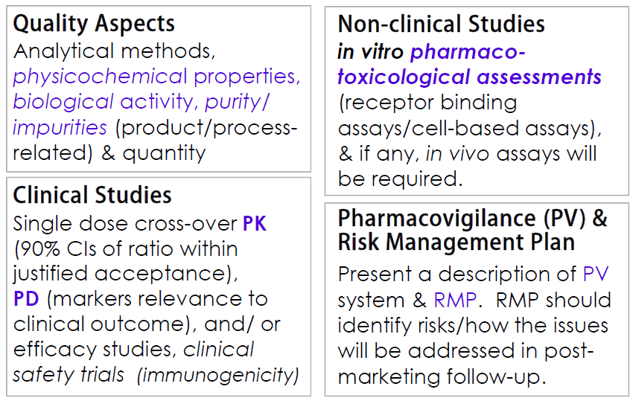
Pedoman evaluasi produk biosimilar di Indonesia oleh BPOM
Pedoman Biosimilar Indonesia 2015

Slide 18

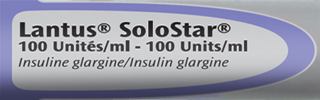
Sanofi memiliki pengalaman jangka panjang
Lebih dari 38 juta pasien dalam 17 tahun
Memiliki data efikasi dan profil keamanan
Solostar® dari Sanofi mudah digunakan, mudah diinjeksikan dan akurat
Lantus DSUR #3 2014 p3.

Slide 19
Kesimpulan:
Setiap produk biologis yang baru berpotensi terjadinya resiko .
Biosimilar yang ada memiliki kualitas yang tinggi, mirip dengan produk innovator tapi tidak identik
Untuk membuktikan biosimilar, kualitas, preklinis, dan PK/PD, studi perbandingan diperlukan
Immunogenicity adalah hal yang mesti diwaspadai

Slide 20
